Slide 1

Alternative Fumigants for Stored Products
….or, Alternatives to Fumigation
Tom Phillips
Department of Entomology
Kansas State University,
Manhattan, KS, USA

Slide 2
Topics Covered Today
IPM for stored grain
Preventive measures
  Aeration
  Residual sprays/grain protectants
Fumigants and alternatives
Summary, questions, discussion

Slide 3
Stored Product IPM Basics:
Prevent, Monitor, Decide: Fumigate, Sell or Hold Steady
Prevention
  Clean bins
  Seal bins (for possible fumigation….)
  Apply residual insecticides to bin and grain
  Store dry grain; aerate to cool grain
Monitor and record temperature, grain quality, and pest presence/numbers
If insect threshold (=comfort level) is surpassed, then fumigate

Slide 4
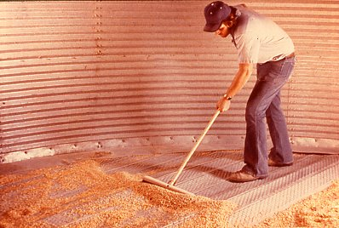

Slide 5
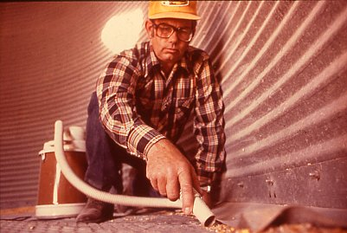

Slide 6
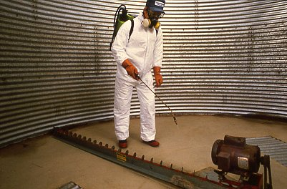
No confined space applications
All applications from outside top hatch

Slide 7
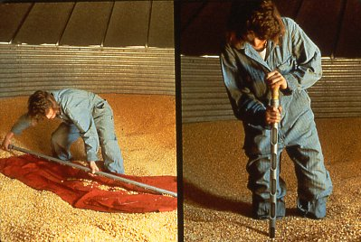
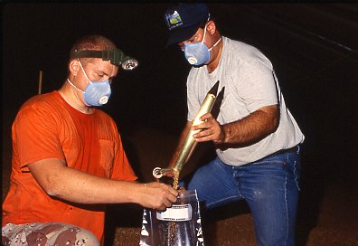
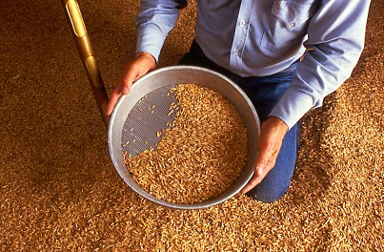
Monitoring Insects by Taking Direct Grain Samples

Slide 8
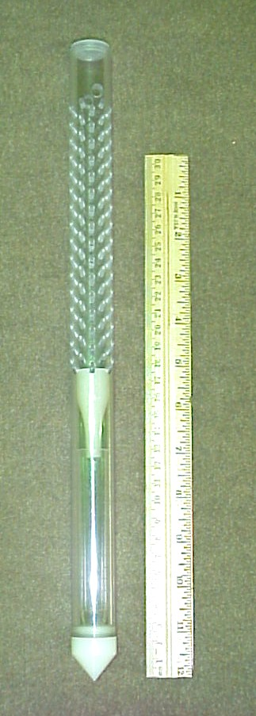
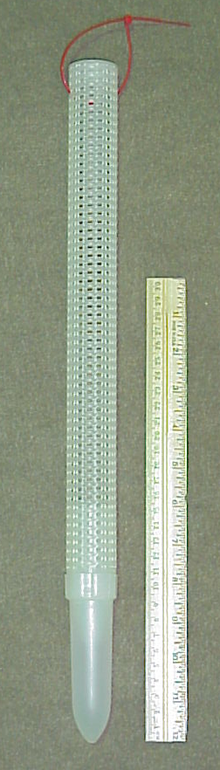
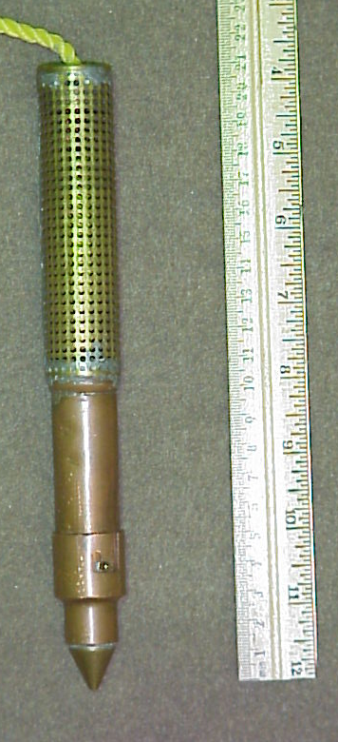
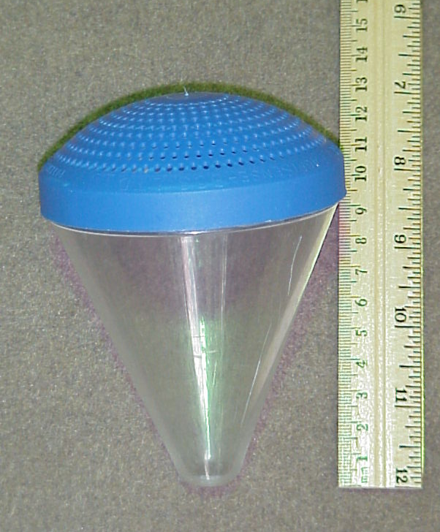
Grain Probe Traps

Slide 9
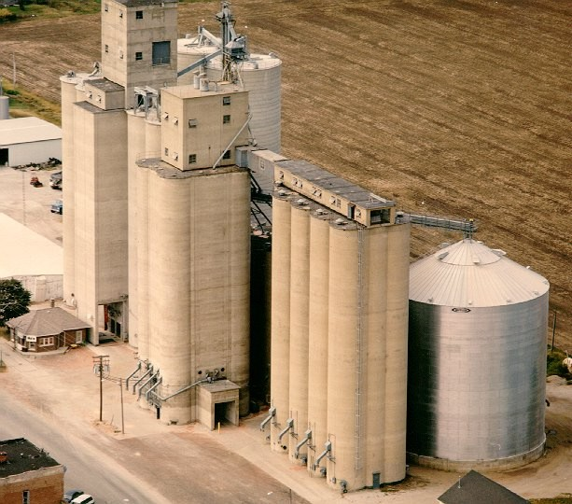
Very Difficult and Expensive to Sample
Large Bins and Silos

Slide 10
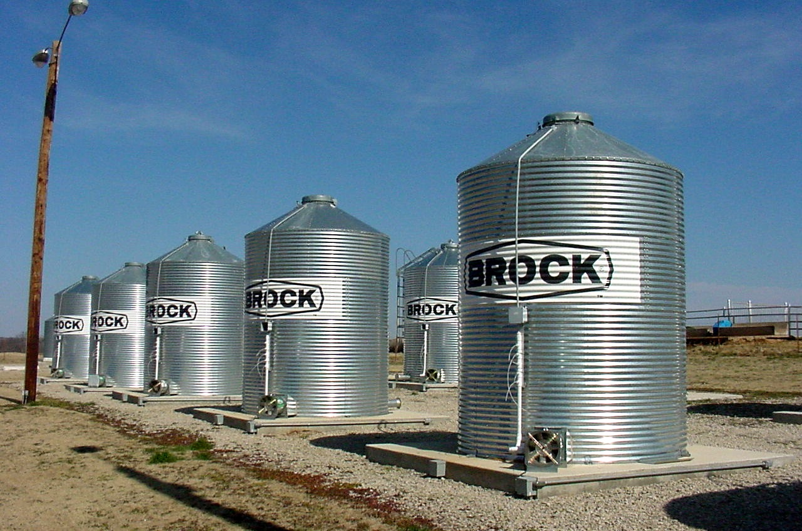
Grain Cooling with Controlled Aeration
Computer controlled temperature monitoring and fan aeration system installed
Compared grain temperatures with summer aeration to no aeration

Slide 11
Average Grain Temperature in 8 Aerated vs 8 Non-aerated Bins
91 F
57 F
36 F
July 21
Dec. 12
Fans turned on when air temperature fell
below grain temperature.

Slide 12
Registered Fumigants in the USA
Methyl Bromide
Phosphine
Sulfuryl Fluoride
Carbon Dioxide

Slide 13
Challenges and Opportunities for Fumigation
Methyl Bromide being banned…
Phosphine resistance in grain insects…
Sulfuryl Fluoride; the learning curve…
Alternative fumigants…?..?..?..?
Residual chemicals in stored products
  Grain protectants
  Surface sprays
Biologically based controls

Slide 14
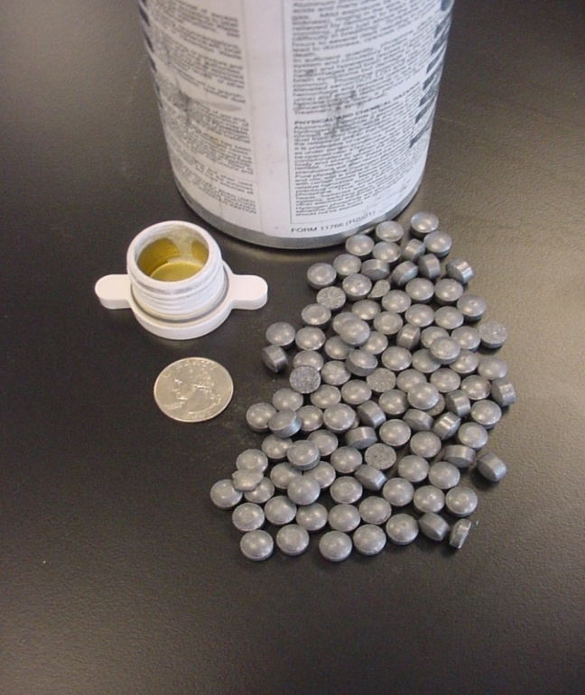
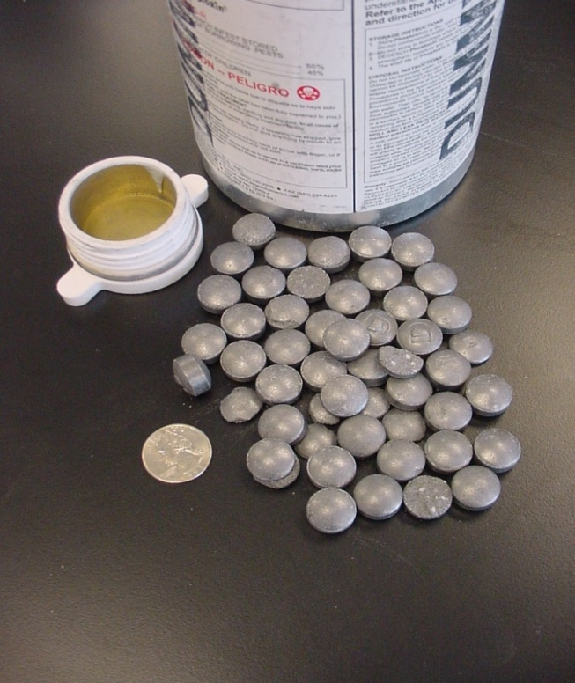
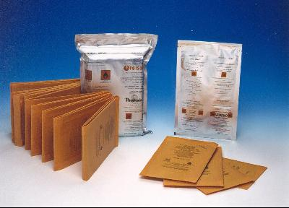
Metallic Phosphide Salts: Most Common
Aluminum Phosphide
AlP + 3H₂O → Al(OH)₃ + PH₃
Magnesium Phosphide
Mg₃P₂ + 6H₂O → 3Mg(OH) ₂ + 2PH₃

Slide 15
Variables that Affect Fumigation Success
Species of target pest
Insects-Most tolerant life stage: egg, larva, pupa, adult
Gas concentration
Exposure time
Temperature

Slide 16
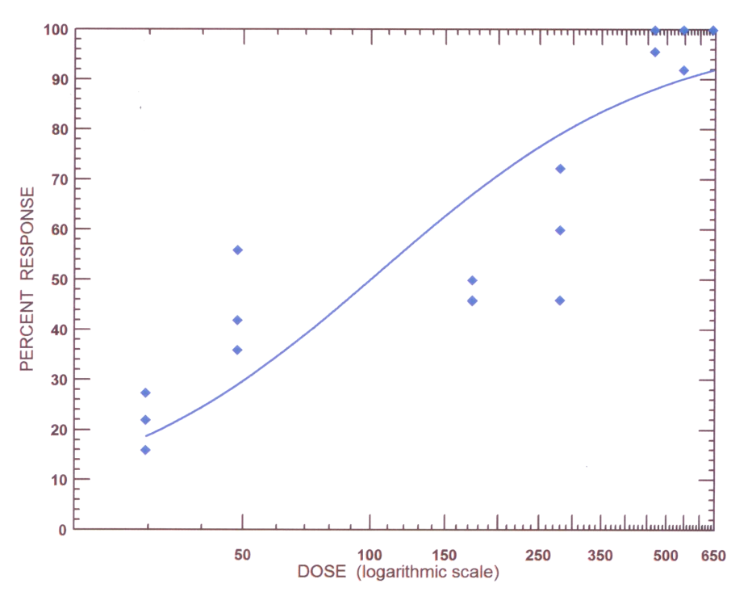
%Kill from Increasing Doses
LD₉₉
Probit Regression can Predict Dose Needed

Slide 17
Dose-Mortality Results at 77ºF

Slide 18
Dose-Mortality Results at 60ºF

Slide 19
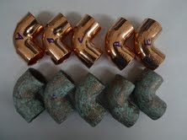
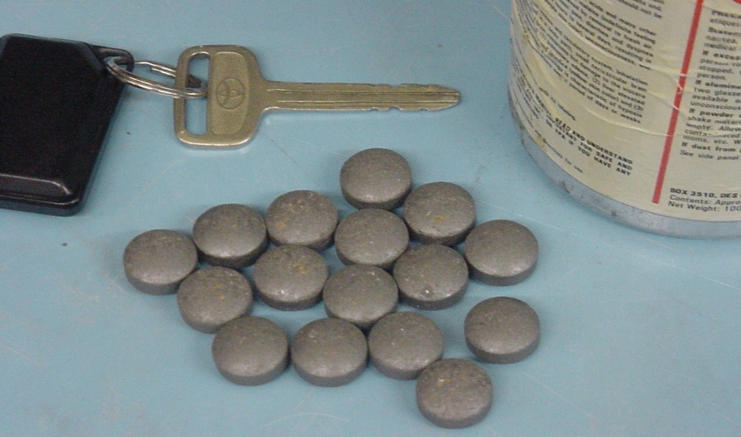
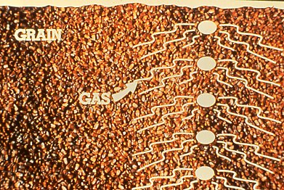
Phosphine: Cheap, Easy and Effective
Gas is light-weight; penetrates well
Tablets/pellets are very economical
Effective for most pests
Corrosive to electrical fixtures
Some insects are resistant,….. and it’s spreading!

Slide 20
Better Phosphine Fumigation
Seal bin very well
Monitor PH3 concentrations with proper equipment
Use higher concentration for much longer time at warm grain temperature: 1000+ ppm, 14 days, 80+ F
Use Phosphine from cylinders for better gas control

Slide 21
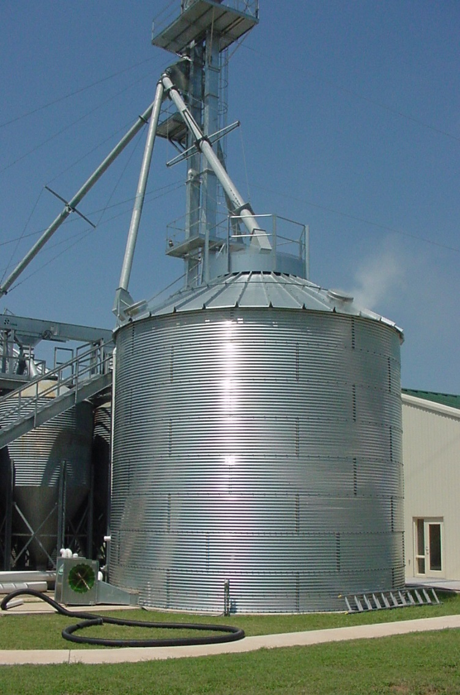
Why are there Failures with Phosphine?
Leaks, leaks and leaks
Too few pellets or tablets
Grain too dry, too cool, or too hot
Poor distribution of gas
High amount of dockage
Bad treatment followed by emergence of survivors
Re-invasion of insects
Insects may be resistant

Slide 22
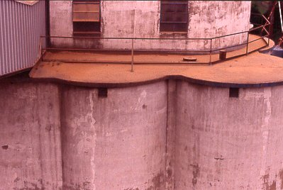
Under-Roof Vents

Slide 23
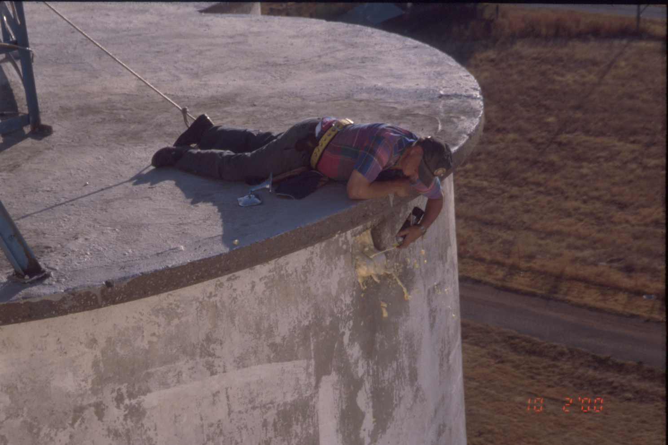
Sealing Under-Roof Vents

Slide 24
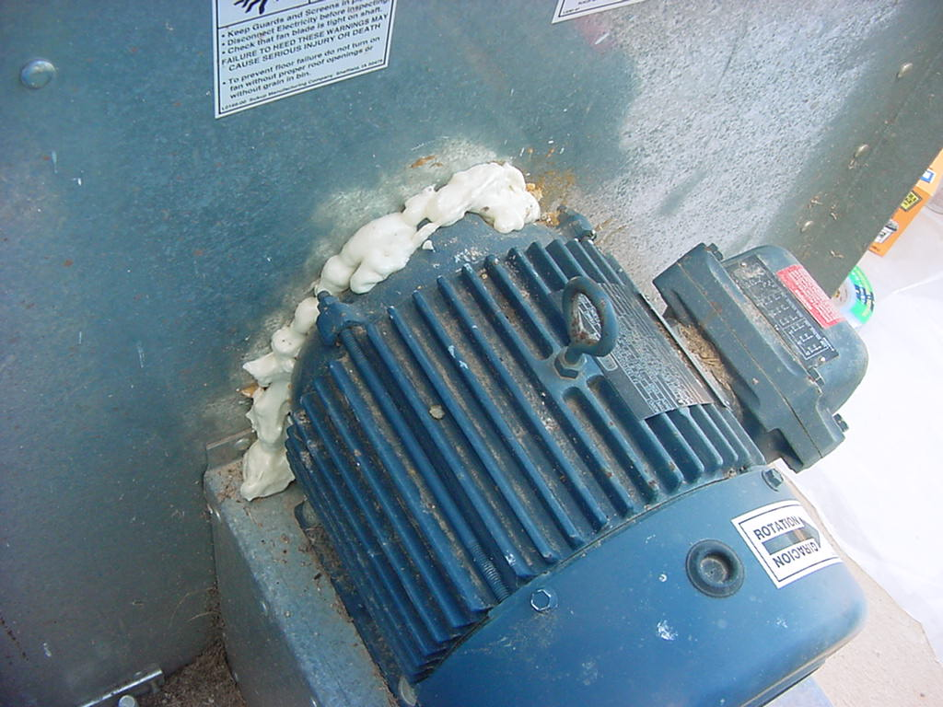
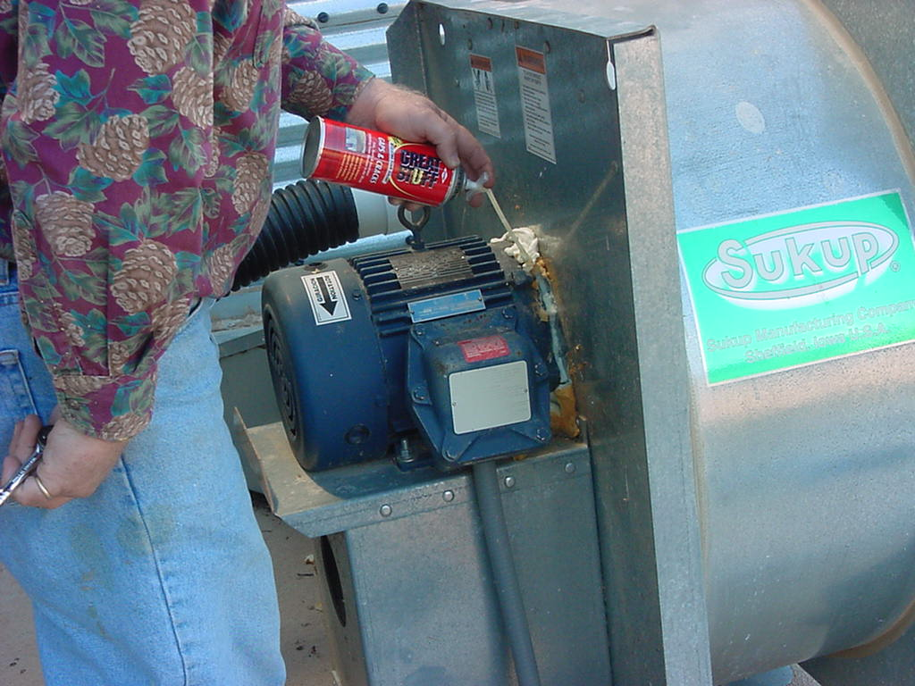
Seal Aeration Fan Motors

Slide 25
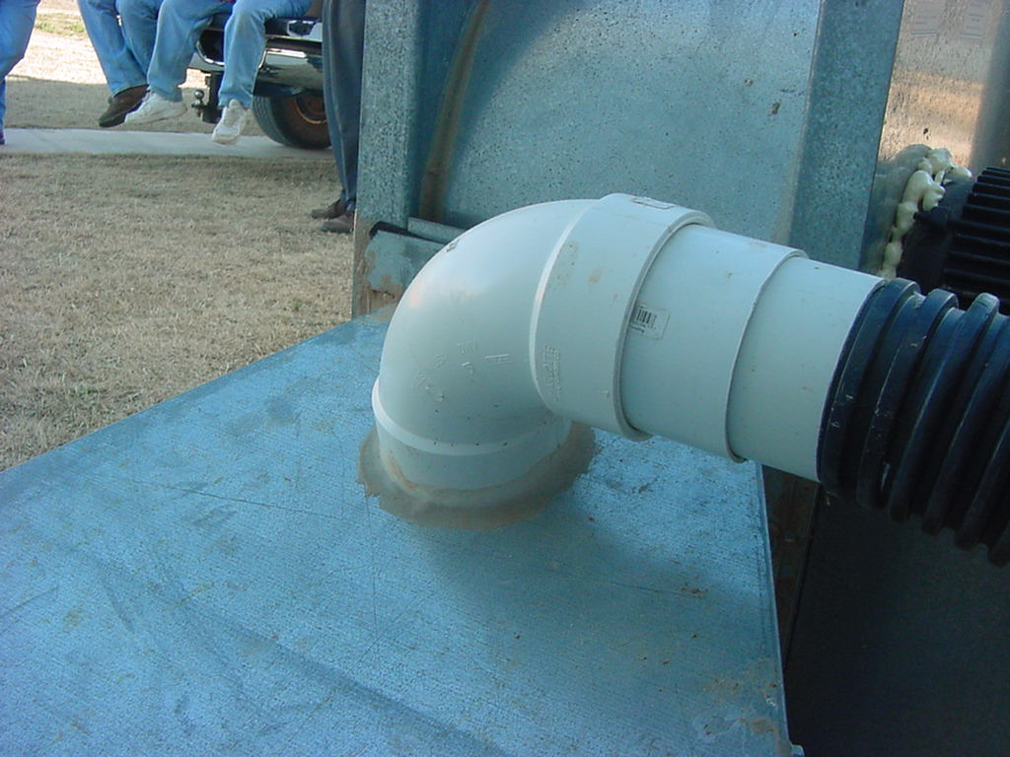
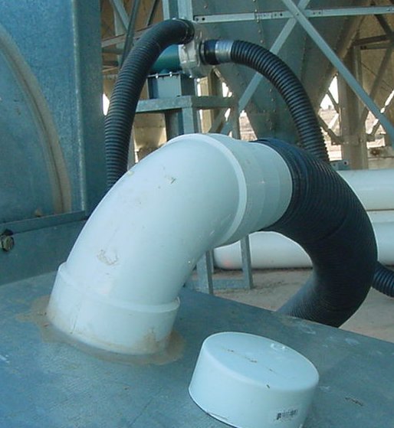
Seal Aeration Fan Transitions

Slide 26
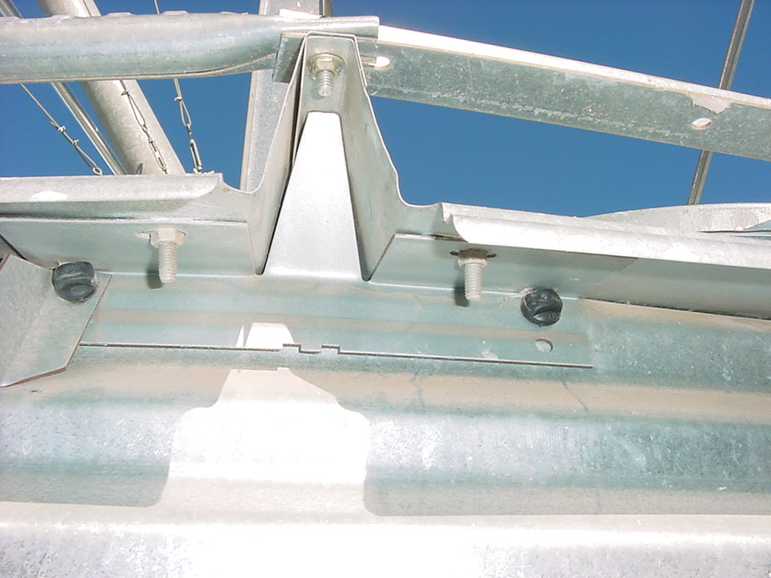
Seal Steel Bin Roof Eaves

Slide 27
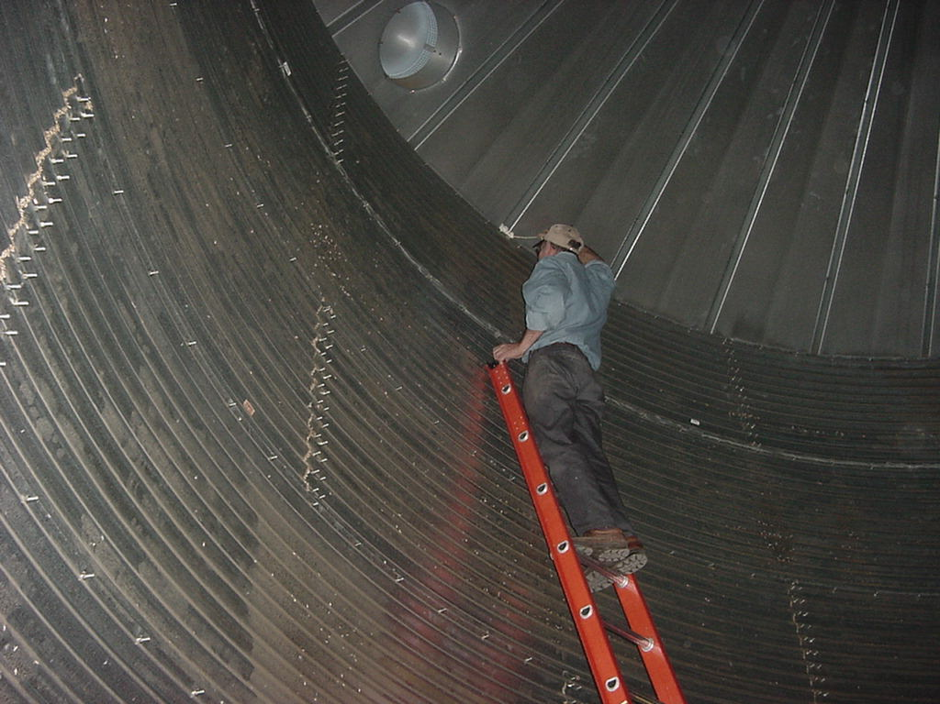
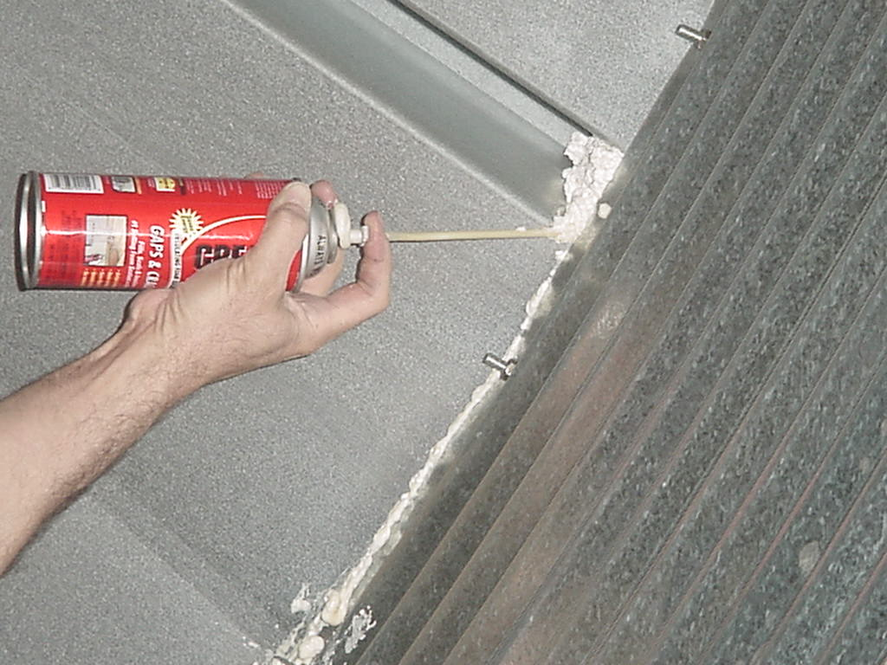
Seal Steel Bin Roof Eaves

Slide 28
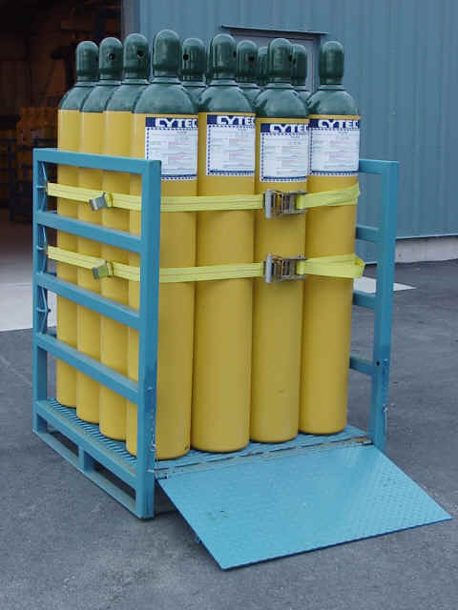
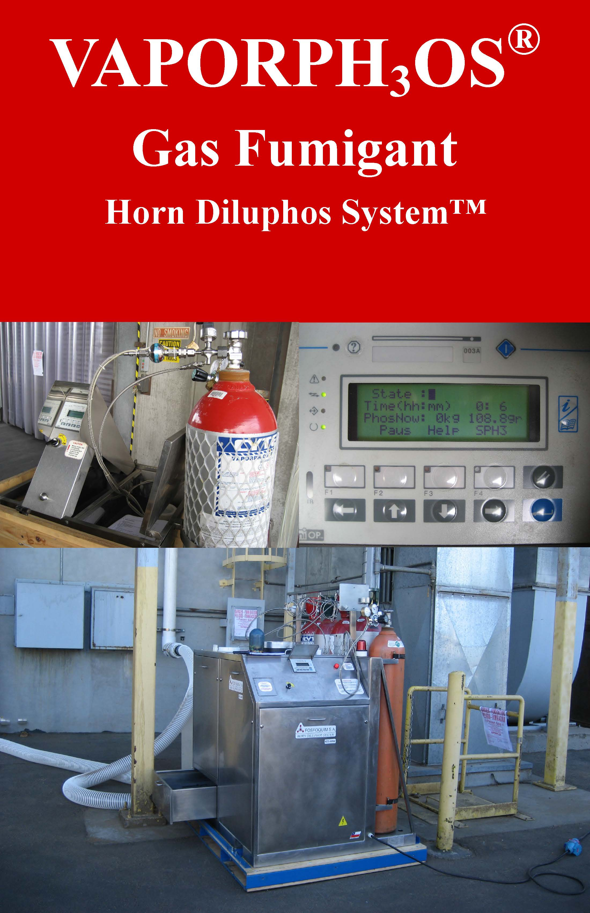
Cylinder-based Phosphine Gas
ECO₂Fume – Approx. 2% Phosphine + 98% CO₂
Vaporphos is >99% Phosphine gas rapidly diluted in air
No confined space entry for application
Will reach target concentration fast
Can add more gas as needed
More expensive than solid phosphides

Slide 29
Phosphine Concentration in Bins

Slide 30
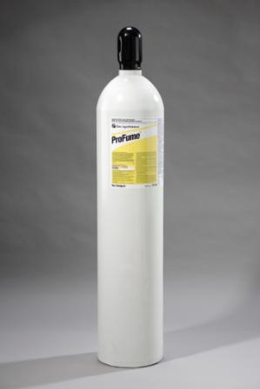

ProFume® = Sulfuryl Fluoride for Food
(same as Vikane ® for non-food structures)
DAS proposed SF as a MB alternative > 15 years ago
Stored gain registration was received first
Now fully registered in US, EU, AU and other countries
Can kill PH3-resistant insects; diff. mode of action
Limited by a maximum dose of 1500 CTP; also some insects hard to kill

Slide 31
SF (ProFume) Loss from Sorption on Grains
Separate experiments done with wheat, corn and rough rice
All jars were held for 7 days; gas samples were taken frequently
Jars were exposed to one of three target concentrations in oz/mcf: 62.5, 31.3 and 15.6
All experiments were conducted at 20, 25 and 30 C
After 7 days each jar was opened, flushed with forced air for 30 seconds, then re-sealed to allow for desorption of SF from the grain.
Samples of air inside desorbing jars were taken at 1, 2, 4 and 24 hrs.

Slide 32
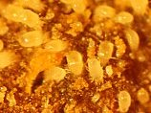
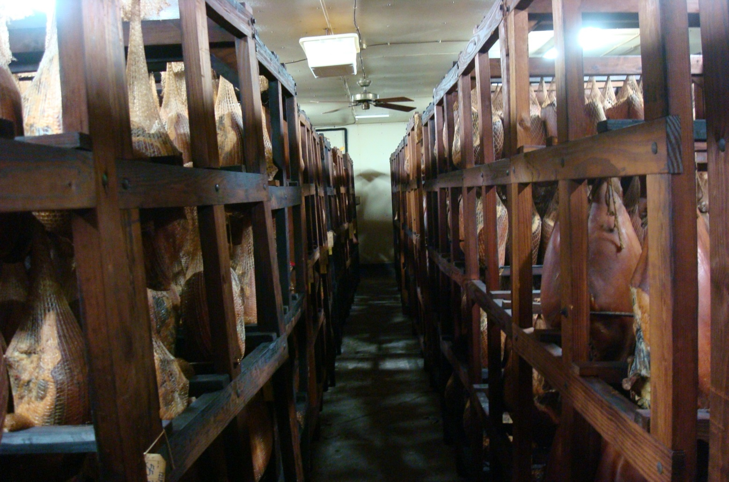
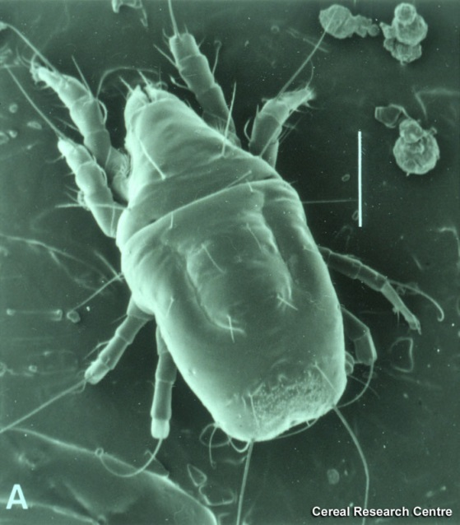
Ham Mite: In Need of MB Alternative

Slide 33
Mortality of Ham Mites under SF: 48h, 25ºC
Above the EPA label rate

Slide 34
ProFume + Heat for Mite Eggs!

Slide 35
Potential limitations to SF
The 1500 CTP is a critical point before which treatment MUST STOP
Sone life stages/species are more tolerant to SF than others, especially at cool temps
Sorption by commodity can limit available gas for killing pests—but CTP applied still holds!
Must be skilled and experienced with SF for cost-effective applications

Slide 36
Alternatives to Current Fumigants
Gases that could be registered by EPA
Controlled or modified atmospheric gases
Biologically-based controls
IPM – Integrated Pest Management

Slide 37

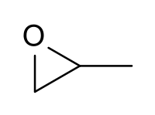


Fumigants with Potential for Registration on Commodities and Structures
Ethyl Formate: food safe
Propylene Oxide, PPO: currently registered antimicrobial
MITC from Metam Sodium: registered soil fumigant
Ethyl Formate
PPO
Metam Sodium
MITC, Methyl Isothiocyanate

Slide 38
Normal Atmosphere
Nitrogen, N₂ = 78.0%
Oxygen, O₂ = 20.9%
Carbon Dioxide, CO₂ = 0.03%
Sea Level Pressure = 760 mm Hg

Slide 39

Controlled Atmosphere: High CO₂
High doses + good sealing + long exposures
Can be very expensive
Best for chamber fumigations, when other chemicals are not advised (museum artifacts)

Slide 40
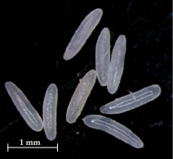
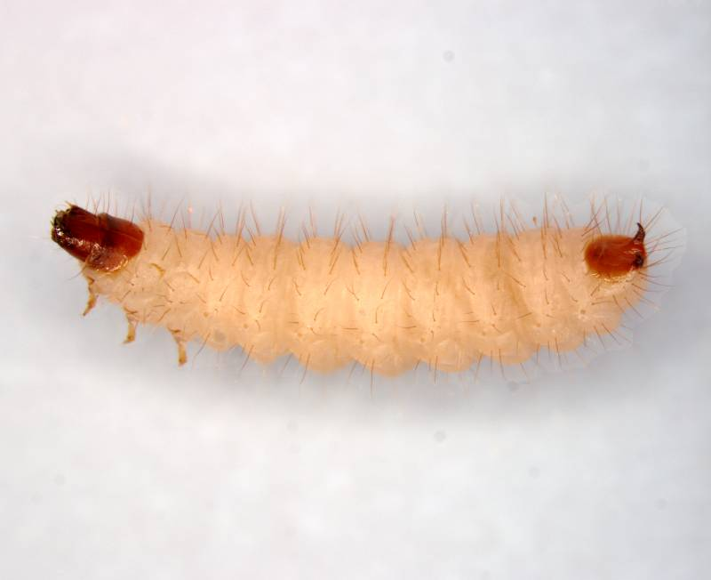
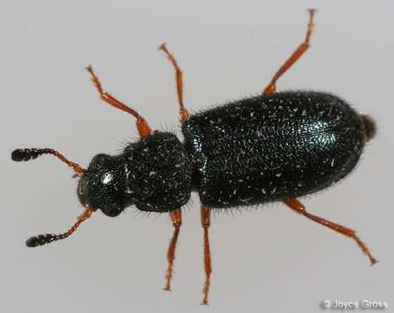
Mortality of Ham Beetles Under CO₂
60% CO₂ was needed to kill 100% ham beetle eggs and adults at 144h

Slide 41
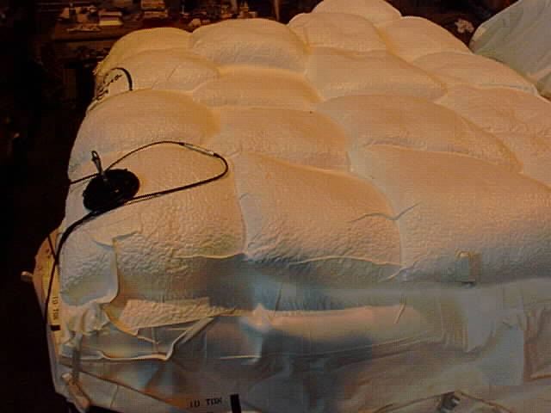
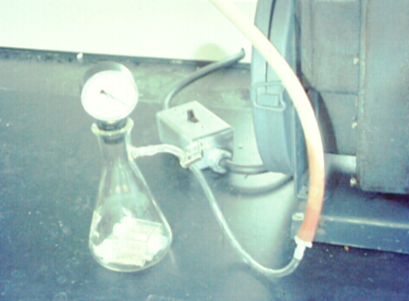
Use a Vacuum Pump to get 1% Oxygen
The “Cocoon” with organic cocoa under vacuum

Slide 42
Biologically Based Controls
Diatomaceous earth: DE, death by desiccation
Bio-pesticide: Spinosad (Sensat®)
Insect Growth Regulators – IGRs
Extreme Temperatures—Heat and Cold

Slide 43
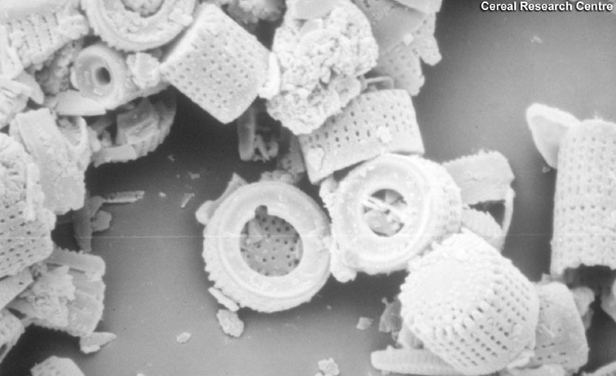
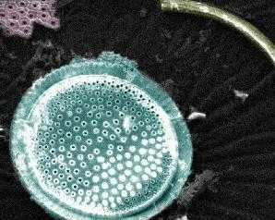
Diatoms

Slide 44
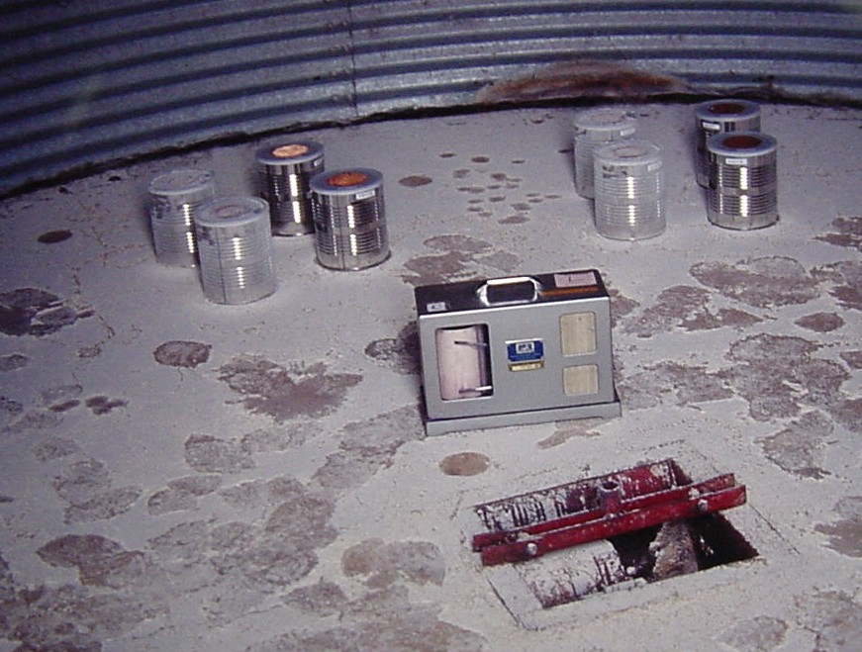

Slide 45
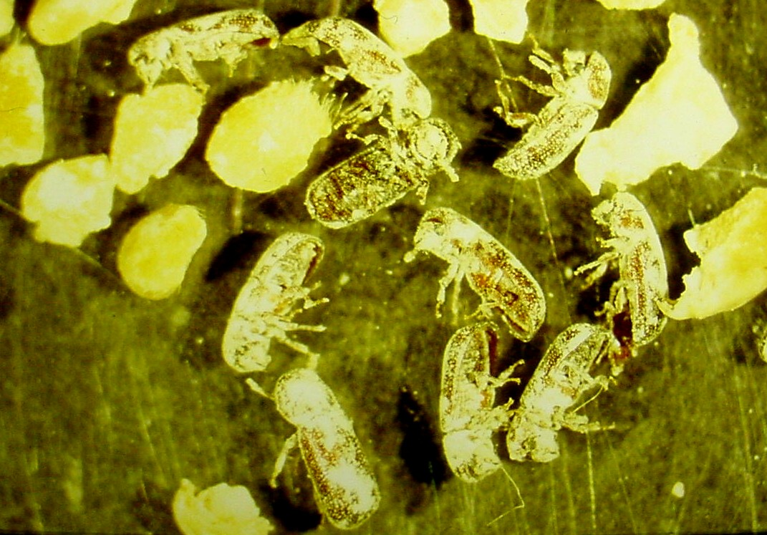

Slide 46
Biological Insecticide: Spinosad
A reduced-risk pesticide – low mammalian and avian toxicity
Derived from a bacterial fermentation product
Broad-spectrum – toxic by ingestion and contact
Extremely effective against lesser grain borer
Registered in U.S. at 1.0 ppm, Bayer has Sensat®…
May/will be approved for Organic Foods

Slide 47
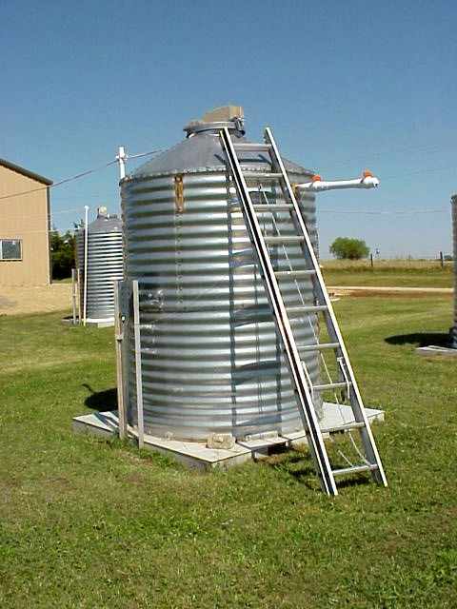
Small Bin Trial of Spinosad at Oklahoma State University
Replicated bin study
Spinosad alone at 1 ppm
Reldan alone at 6 ppm
Untreated bins
Grain stored 2 years with no other treatments

Slide 48
Average No. of Insect-Damaged Kernels, IDK, per 100g Sample after Two Years (32+ IDK not for humans)
Untreated 130
Reldan 942
Spinosad 2

Slide 49
What is an IGR?
IGR = Insect Growth Regulator
Chemical mimic of insect growth hormone
Does not kill adults or larvae directly
Insect dies when molting is disrupted
Extremely non-toxic and insect specific
Very safe for applicators and for food residues

Slide 50
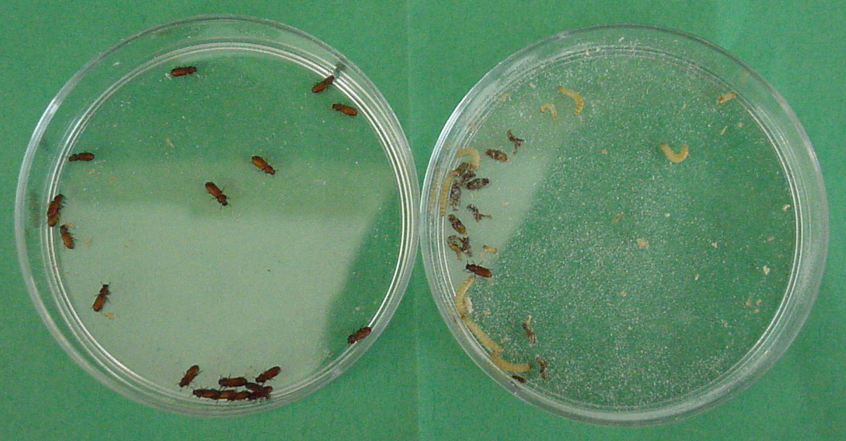
Effects of IGRs-Insects put on surface as larvae….
Developed on Untreated Surface
Developed on Treated Surface

Slide 51
Effective Grain Protectants
Possible Alternative of PH3 Resistant Pest
** Represent different AI **
** Must apply while turning grain **
Spinosad (bacteria isolate; maybe not available)
Centynal (deltamethrin)
Storcide II (combination of deltamethrin + Reldan)
Diacon II (methoprene IGR)
Phantom (chlorfenapyr; labeled for surfaces)

Slide 52
Summary and Conclusions
Methyl Bromide is now gone for domestic uses
Phosphine resistance is spreading in grain insects
Resistance management is needed to preserve phosphine
ProFume is a PH₃ alternative. Good sealing, adequate exposure and warm temperatures are needed to kill tolerant life stages (eggs, pupae)
Grain managers will need to adjust their culture to use PH₃ effectively and try various alternatives if needed
Adopt an IPM program with prevention and monitoring and then proper, effective fumigation as an action tool

Slide 53
Thank You Very Much
Tom Phillips
785-532-4720
twp1@ksu.edu

